Slide 1
Bayesian Learning
Bayes Theorem
MAP, ML hypotheses
MAP learners
Minimum description length principle
Bayes optimal classifier
Naïve Bayes learner
Bayesian belief networks
Bayesian Methods

Slide 2
Two Roles for Bayesian Methods
Provide practical learning algorithms:
Naïve Bayes learning
Bayesian belief network learning
Combine prior knowledge (prior probabilities) with observed data
Requires prior probabilities:
Provides useful conceptual framework:
Provides “gold standard” for evaluating other learning algorithms
Additional insight into Occam’s razor
Bayesian Methods

Slide 3
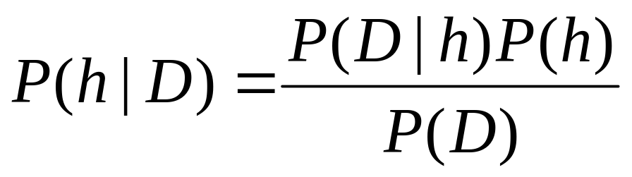
Bayes Theorem
P(h) = prior probability of hypothesis h
P(D) = prior probability of training data D
P(h|D) = probability of h given D
P(D|h) = probability of D given h
Bayesian Methods

Slide 4
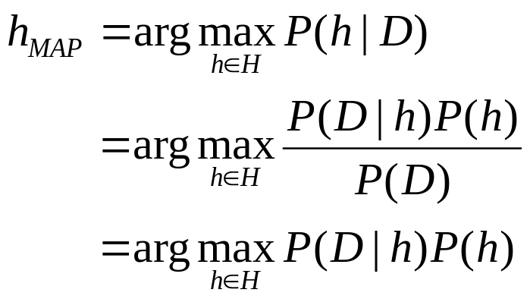
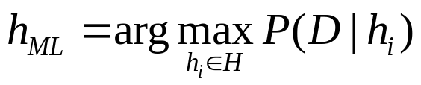
Choosing Hypotheses
Generally want the most probable hypothesis given the training data
Maximum a posteriori hypothesis h_{MAP}:
If we assume P(h_{i})=P(h_{j}) then can further simplify, and choose the Maximum likelihood (ML) hypothesis
Bayesian Methods

Slide 5
Bayes Theorem
Does patient have cancer or not?
A patient takes a lab test and the result comes back positive. The test returns a correct positive result in only 98% of the cases in which the disease is actually present, and a correct negative result in only 97% of the cases in which the disease is not present. Furthermore, 0.8% of the entire population have this cancer.
P(cancer) = P(¬cancer) =
P(+|cancer) = P(-|cancer) =
P(+|¬cancer) = P(-|¬cancer) =
P(cancer|+) =
P(¬cancer|+) =
Bayesian Methods

Slide 6
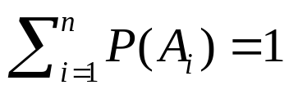
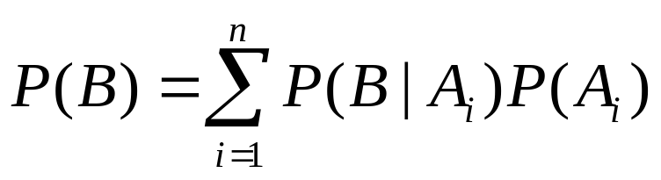
Some Formulas for Probabilities
Product rule: probability P(A ∧ B) of a conjunction of two events A and B:
  P(A ∧ B) = P(A|B)P(B) = P(B|A)P(A)
Sum rule: probability of disjunction of two events A and B:
  P(A ∨ B) = P(A) + P(B) - P(A ∧ B)
Theorem of total probability: if events A₁,…,A_{n} are mutually exclusive with , then
Bayesian Methods

Slide 7
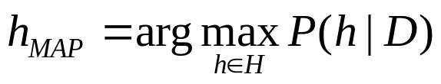
Brute Force MAP Hypothesis Learner
1. For each hypothesis h in H, calculate the posterior probability
2. Output the hypothesis h_{MAP} with the highest posterior probability
Bayesian Methods

Slide 8
Relation to Concept Learning
Consider our usual concept learning task
instance space X, hypothesis space H, training examples D
consider the FindS learning algorithm (outputs most specific hypothesis from the version space VS_{H,D})
What would Bayes rule produce as the MAP hypothesis?
Does FindS output a MAP hypothesis?
Bayesian Methods

Slide 9
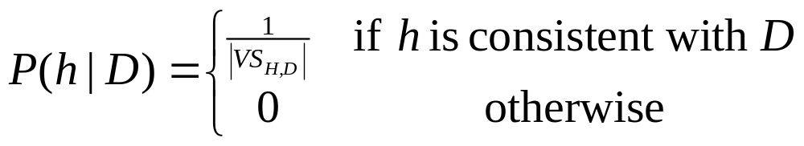
Relation to Concept Learning
Assume fixed set of instances (x₁,…,x_{m})
Assume D is the set of classifications
D = (c(x₁),…,c(x_{m}))
Choose P(D|h):
P(D|h) = 1 if h consistent with D
P(D|h) = 0 otherwise
Choose P(h) to be uniform distribution
P(h) = 1/|H| for all h in H
Then
Bayesian Methods

Slide 10
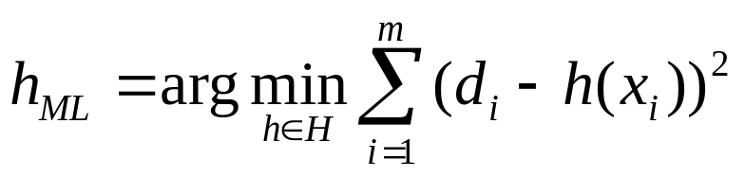
Learning a Real Valued Function
y
f
e
h_{ML}
x
Consider any real-valued target function f
Training examples (x_{i},d_{i}), where d_{i} is noisy training value
d_{i} = f(x_{i}) + e_{i}
e_{i} is random variable (noise) drawn independently for each
x_{i} according to some Gaussian distribution with mean = 0
Then the maximum likelihood hypothesis h_{ML} is the one that
minimizes the sum of squared errors:
Bayesian Methods

Slide 11
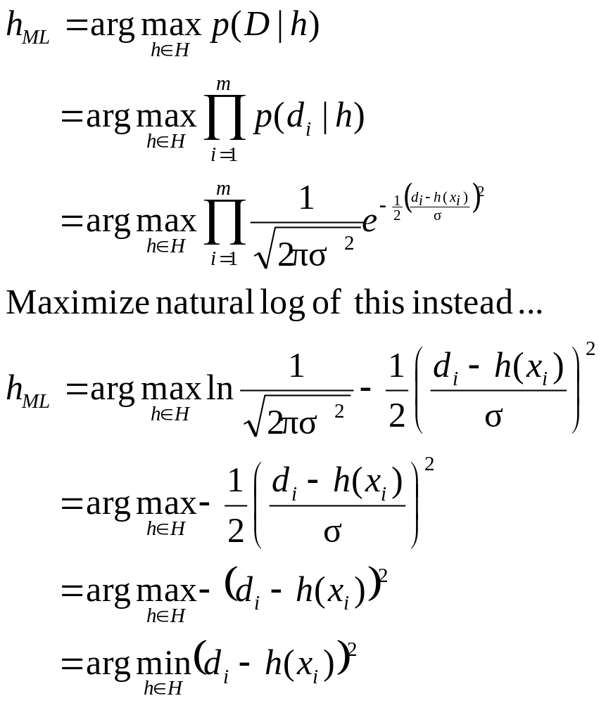
Learning a Real Valued Function
Bayesian Methods

Slide 12
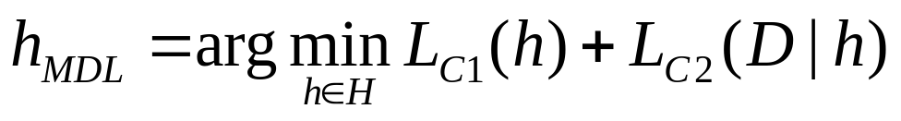
Minimum Description Length Principle
Occam’s razor: prefer the shortest hypothesis
MDL: prefer the hypothesis h that minimizes
where L_{C}(x) is the description length of x under encoding C
Example:
H = decision trees, D = training data labels
L_{C1}(h) is # bits to describe tree h
L_{C2}(D|h) is #bits to describe D given h
  Note L_{C2} (D|h) = 0 if examples classified perfectly by h. Need only describe exceptions
Hence h_{MDL} trades off tree size for training errors
Bayesian Methods

Slide 13
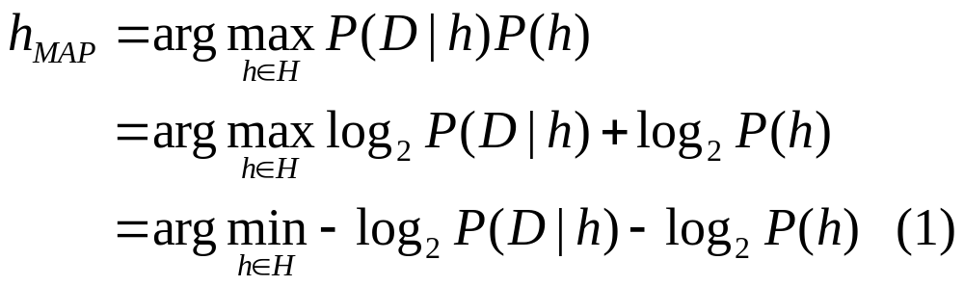
Minimum Description Length Principle
Interesting fact from information theory:
  The optimal (shortest expected length) code for an event with probability p is log₂p bits.
So interpret (1):
-log₂P(h) is the length of h under optimal code
-log₂P(D|h) is length of D given h in optimal code
→ prefer the hypothesis that minimizes
length(h)+length(misclassifications)
Bayesian Methods

Slide 14
Naïve Bayes Classifier
Along with decision trees, neural networks, nearest neighor, one of the most practical learning methods.
When to use
Moderate or large training set available
Attributes that describe instances are conditionally independent given classification
Successful applications:
Diagnosis
Classifying text documents
Bayesian Methods

Slide 15
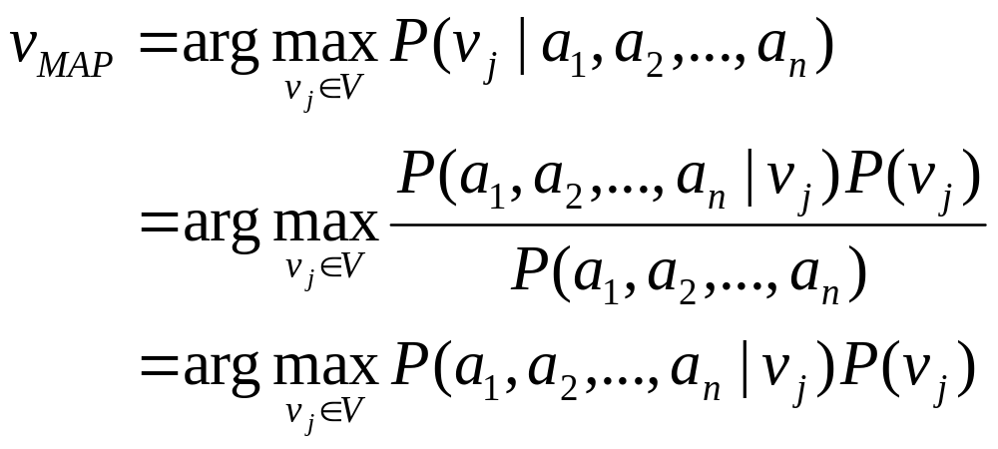
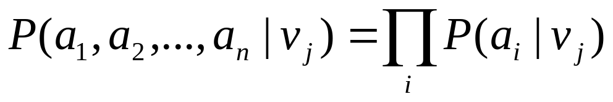
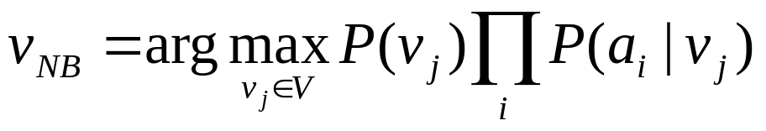
Naïve Bayes Classifier
Assume target function f: X→V, where each instance x described by attributed (a₁,a₂,…,a_{n}).
Most probable value of f(x) is:
Naïve Bayes assumption:
which gives
Naïve Bayes classifier:
Bayesian Methods

Slide 16
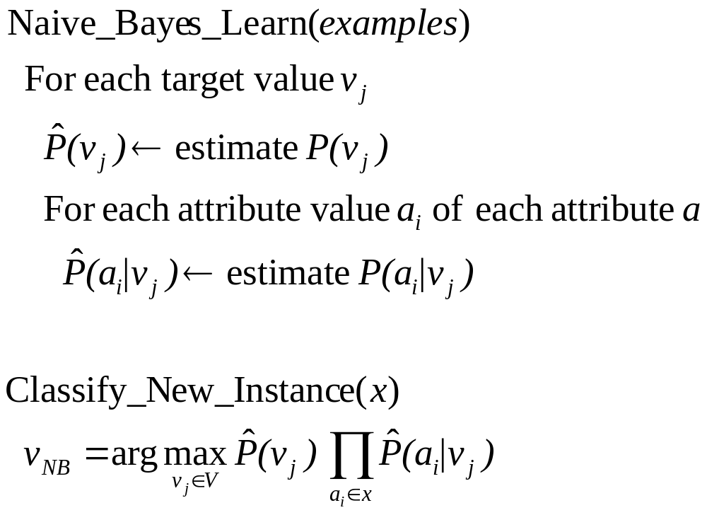
Naïve Bayes Algorithm
Bayesian Methods

Slide 17
Naïve Bayes Example
Consider CoolCar again and new instance
(Color=Blue,Type=SUV,Doors=2,Tires=WhiteW)
Want to compute
P(+)*P(Blue|+)*P(SUV|+)*P(2|+)*P(WhiteW|+)=
5/14 * 1/5 * 2/5 * 4/5 * 3/5 = 0.0137
P(-)*P(Blue|-)*P(SUV|-)*P(2|-)*P(WhiteW|-)=
9/14 * 3/9 * 4/9 * 3/9 * 3/9 = 0.0106
Bayesian Methods

Slide 18
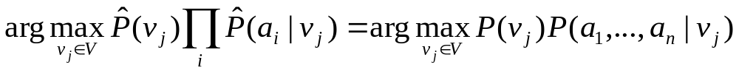
Naïve Bayes Subtleties
1. Conditional independence assumption is often violated
… but it works surprisingly well anyway. Note that you do not need estimated posteriors to be correct; need only that
see Domingos & Pazzani (1996) for analysis
Naïve Bayes posteriors often unrealistically close to 1 or 0
Bayesian Methods

Slide 19
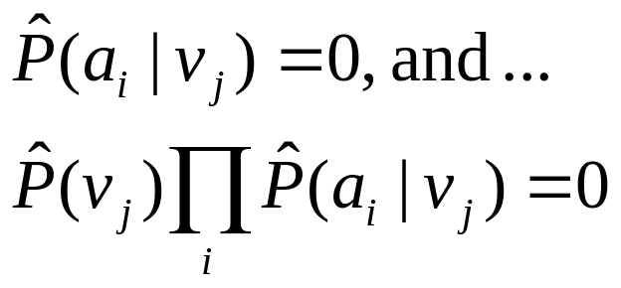
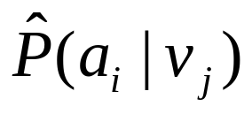
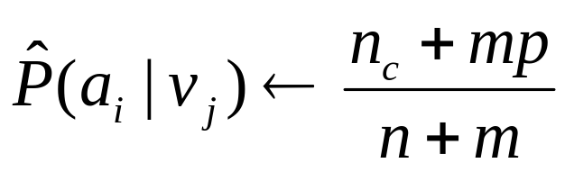
Naïve Bayes Subtleties
2. What if none of the training instances with target value v_{j} have attribute value a_{i}? Then
Typical solution is Bayesian estimate for
n is number of training examples for which v=v_{j}
n_{c} is number of examples for which v=v_{j} and a=a_{i}
p is prior estimate for
m is weight given to prior (i.e., number of “virtual” examples)
Bayesian Methods

Slide 20
Bayesian Belief Networks
Interesting because
Naïve Bayes assumption of conditional independence is too restrictive
But it is intractable without some such assumptions…
Bayesian belief networks describe conditional independence among subsets of variables
allows combing prior knowledge about (in)dependence among variables with observed training data
(also called Bayes Nets)
Bayesian Methods

Slide 21
Conditional Independence
Definition: X is conditionally independent of Y given Z if the probability distribution governing X is independent of the value of Y given the value of Z; that is, if
  more compactly we write
  P(X|Y,Z) = P(X|Z)
Example: Thunder is conditionally independent of Rain given Lightning
  P(Thunder|Rain,Lightning)=P(Thunder|Lightning)
Naïve Bayes uses conditional ind. to justify
  P(X,Y|Z)=P(X|Y,Z)P(Y|Z)
  =P(X|Z)P(Y|Z)
Bayesian Methods

Slide 22
Bayesian Belief Network
Storm
BusTourGroup
S,B S,¬B ¬S,B ¬S,¬B
C 0.4 0.1 0.8 0.2
¬C 0.6 0.9 0.2 0.8
Lightning
Campfire
Campfire
Thunder
ForestFire
Network represents a set of conditional independence assumptions
Each node is asserted to be conditionally independent of its
nondescendants, given its immediate predecessors
Directed acyclic graph
Bayesian Methods

Slide 23
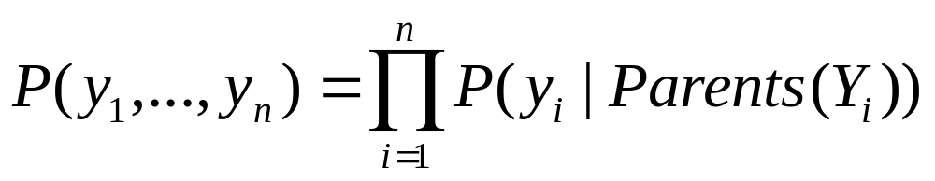
Bayesian Belief Network
Represents joint probability distribution over all variables
e.g., P(Storm,BusTourGroup,…,ForestFire)
in general,
  where Parents(Y_{i}) denotes immediate predecessors of Y_{i} in graph
so, joint distribution is fully defined by graph, plus the P(y_{i}|Parents(Y_{i}))
Bayesian Methods

Slide 24
Inference in Bayesian Networks
How can one infer the (probabilities of) values of one or more network variables, given observed values of others?
Bayes net contains all information needed
If only one variable with unknown value, easy to infer it
In general case, problem is NP hard
In practice, can succeed in many cases
Exact inference methods work well for some network structures
Monte Carlo methods “simulate” the network randomly to calculate approximate solutions
Bayesian Methods

Slide 25
Learning of Bayesian Networks
Several variants of this learning task
Network structure might be known or unknown
Training examples might provide values of all network variables, or just some
If structure known and observe all variables
Then it is easy as training a Naïve Bayes classifier
Bayesian Methods

Slide 26
Learning Bayes Net
Suppose structure known, variables partially observable
e.g., observe ForestFire, Storm, BusTourGroup, Thunder, but not Lightning, Campfire, …
Similar to training neural network with hidden units
In fact, can learn network conditional probability tables using gradient ascent!
Converge to network h that (locally) maximizes P(D|h)
Bayesian Methods

Slide 27
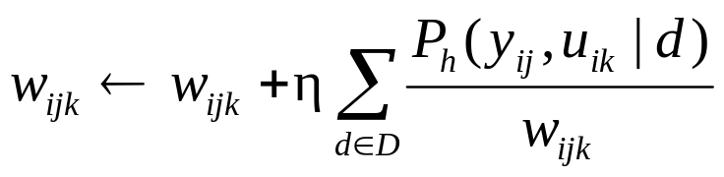
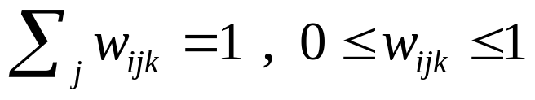
Gradient Ascent for Bayes Nets
Let w_{ijk} denote one entry in the conditional probability table for variable Y_{i} in the network
w_{ijk} =P(Yi=yij|Parents(Y_{i})=the list u_{ik} of values)
e.g., if Y_{i} = Campfire, then u_{ik} might be (Storm=T, BusTourGroup=F)
Perform gradient ascent by repeatedly
1. Update all w_{ijk} using training data D
2. Then renormalize the w_{ijk} to assure
Bayesian Methods

Slide 28
Summary of Bayes Belief Networks
Combine prior knowledge with observed data
Impact of prior knowledge (when correct!) is to lower the sample complexity
Active research area
  Extend from Boolean to real-valued variables
  Parameterized distributions instead of tables
  Extend to first-order instead of propositional systems
  More effective inference methods
Bayesian Methods

